Slide 1
Module 1
Introduction

Slide 2
CS108 - Foundations of Data Science – F22
Venue: CS 140
Lectures: TuTh 8:30am – 9:45am
Labs: 9:05am -9:55am Fri
Instructor: Purity Mugambi
TA: Virginia Partridge

Slide 3
About your instructors
Purity Mugambi
5th year PhD candidate
Research in development of ML tools to detect (and improve) health equity in patient treatments and outcomes
OH: Th, 10am-11am, LGRC Rm. A205
Virginia Partridge

Slide 4
Data Science

Slide 5



What is Data Science?
DS is the discipline of drawing useful conclusions from data using computation
Exploration
Identifying patterns in information
Uses visualizations
Inference
Quantifying whether those patterns are reliable
Uses randomization
Prediction
Making informed guesses
Uses machine learning
Notes:
There are three core aspects of effective data analysis: exploration, prediction, and inference.

Slide 6
Applications
Data science is driven by applications
Data analysis is playing an increasingly important role in many fields including:
Biology, Chemistry, Economics, Earth Systems, Education, Environmental Science, Finance, Geography, Geology, Kinesiology, Linguistics, Management, Political Science, Public Health, Psychology, Sociology, …
Every data-driven subject brings new challenges

Slide 7
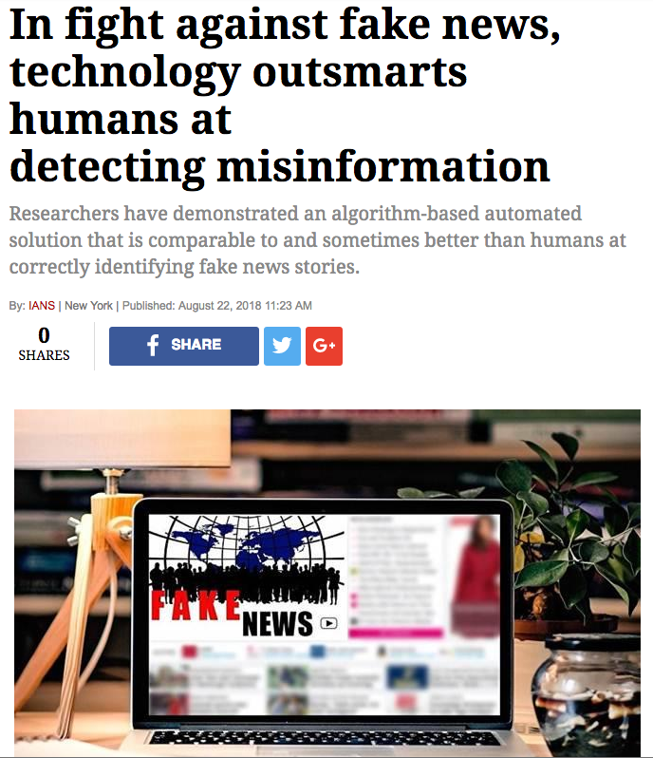

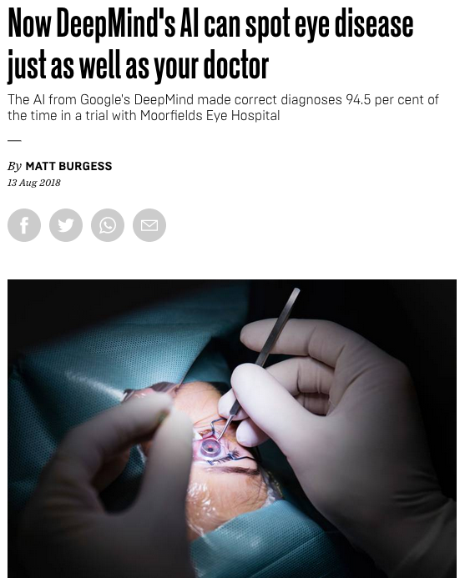

Examples

Slide 8
Course Structure

Slide 9
What does the course cover?
An introduction to programming in Python with a focus on manipulating, visualizing, and analyzing data.
An introduction to statistics that is grounded in computer simulations.
An introduction to predictive modeling and machine learning.

Slide 10
Course Components and Grading
Lectures (often interactive)
Weekly labs including attendance (pass/fail)
Weekly graded homework assignments
Midterm exam & final exam
Homework | 35%
Labs | 20%
Midterm Exam | 20%
Final Exam | 25%

Slide 11
Course Technology
Moodle: Online gradebook
Github.io: Course website (lecture slides, demos, assignments, labs, syllabus, etc.)
DataHub: Web-based Python compute environment for completing labs and homework assignments.
Gradescope: Assignments, labs, and exams submission system
Links to all resource can be found on Moodle.

Slide 12
Course Policies
Late Homework
Re-grades
Academic Honesty
https://umass-data-science.github.io/190fwebsite/policies/

Slide 13
Collaboration Policy
Asking questions is highly encouraged
You can discuss homework and lab questions with each other
Do not take notes or pictures out of discussions
The work you turn in must be your own
The Limits of collaboration
Don't share solution material of any type with each other
Copying solutions from any source will be dealt with under UMass’ Academic Honesty procedures: https://www.umass.edu/honesty/

Slide 14
Getting Help
The course staff are here to help you be successful in the course!
When you need help come to office hours.
The lab sessions are also a good time to ask questions and get help.

Slide 15
ON USING DATAHUB

Slide 16
Datahub
If you have an @umass.edu email address, you should now be able to access the course’s data hub.
Datahub uses UMass Google Apps authentication. Use your @umass.edu email address and Spire password to log in. It takes a minute to start up.
When you’re done working with the Datahub, make sure to shut your datahub server down and then log out.

Slide 17
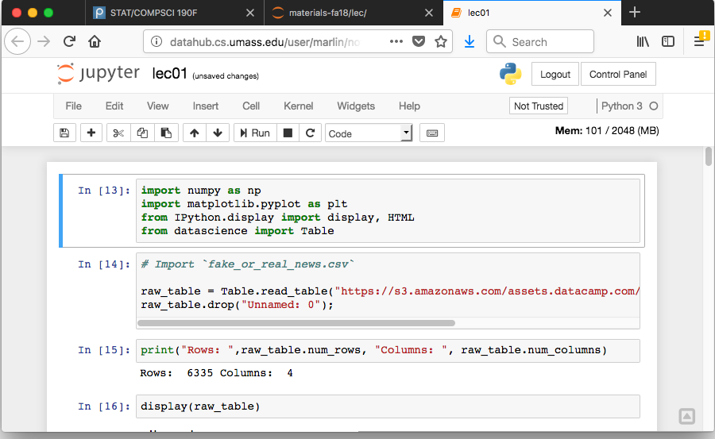
Stopping Your Data Hub

Slide 18
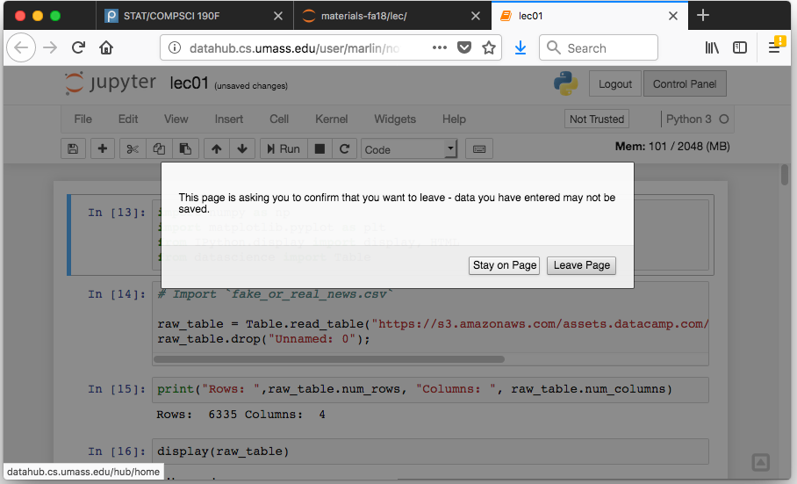
Stopping Your Data Hub

Slide 19
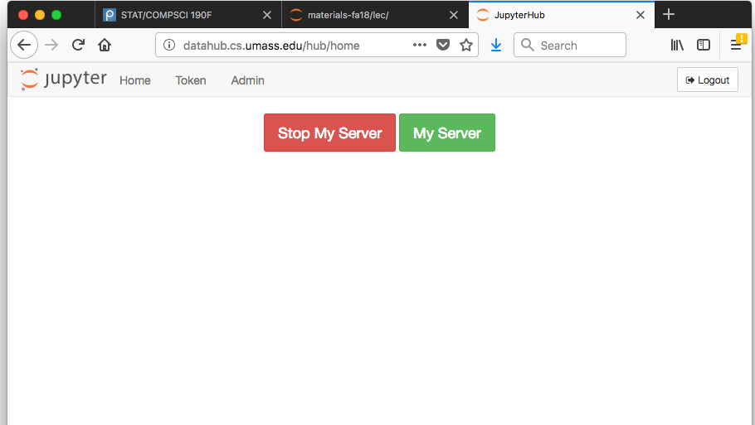
Stopping Your Data Hub

Slide 20
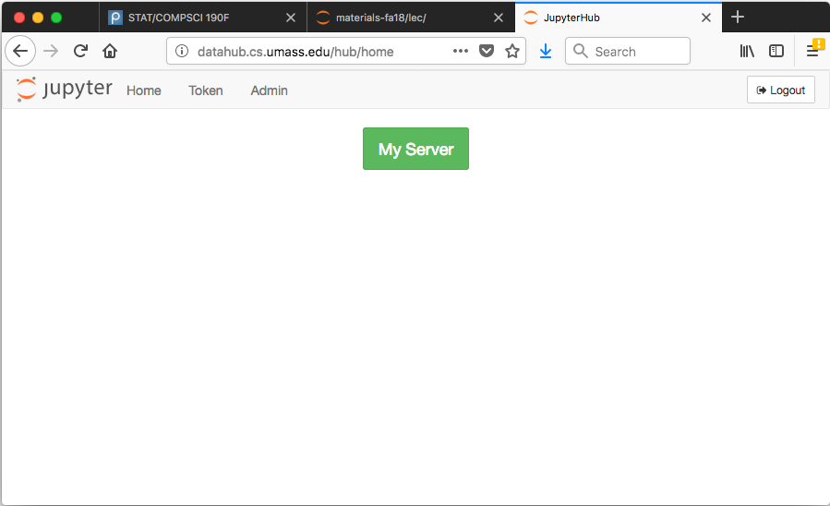
Stopping Your Data Hub

Slide 21
Cause and Effect

Slide 22
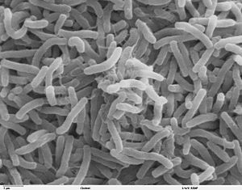
Broad Street Cholera Outbreak
The Broad Street cholera outbreak was a severe outbreak of cholera that occurred in 1854 near Broad Street in the Soho district of London, England.
This outbreak killed 616 people.

Slide 23
Two Theories of Cholera
Miasma theory: cholera was caused by particles in the air, or "miasmata", which arose from decomposing matter or other dirty organic sources.
Germ theory: the principal cause of cholera was a germ cell that had not yet been identified but was transmitted through food or drink.

Slide 24
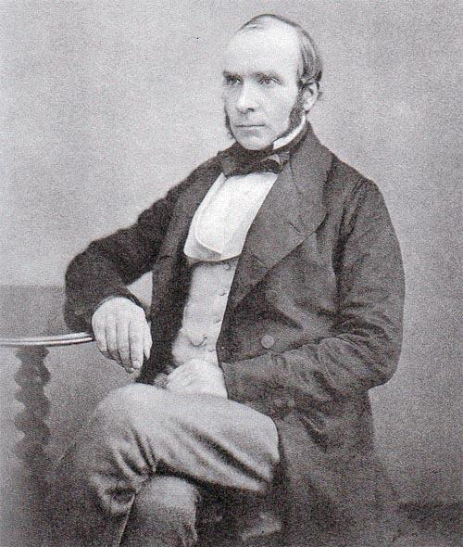
John Snow, 1813-1858

Slide 25
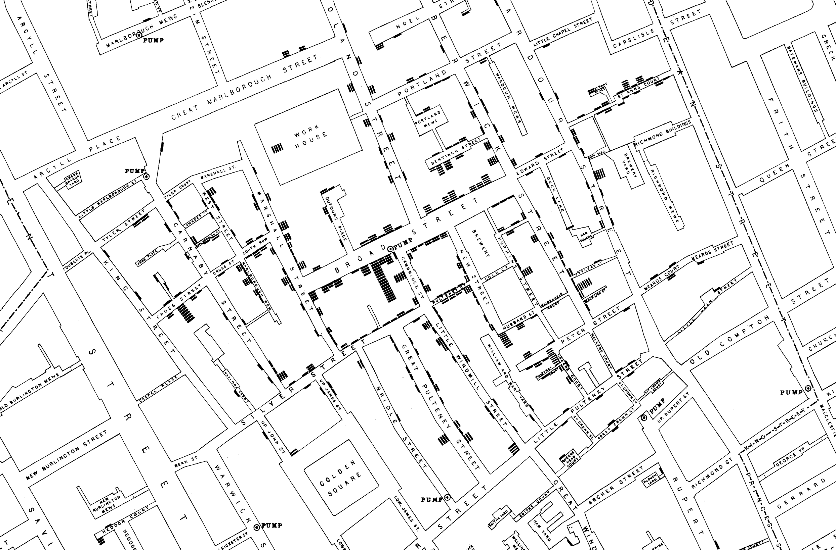
Notes:
- John Snow had a theory that cholera was caused by sewage infusing into people’s drinking water. Hence the germ from infected people with cholera could sip into the water drunk by the health when the sewage leaked into the drinking water.
John took notes of every reported death in Soho by marking it on the map of Soho above.
Each bar represented one death, and the black (circled points in grey) are the pumps in Soho
He noticed almost immediately that deaths were concentrated near the broad street water pump (highlighted in red)
After further investigation, it was found that a cesspit was leaking into the pump
Using this map, he was able to convince the authorities to investigate further and break the handle of the pump

Slide 26
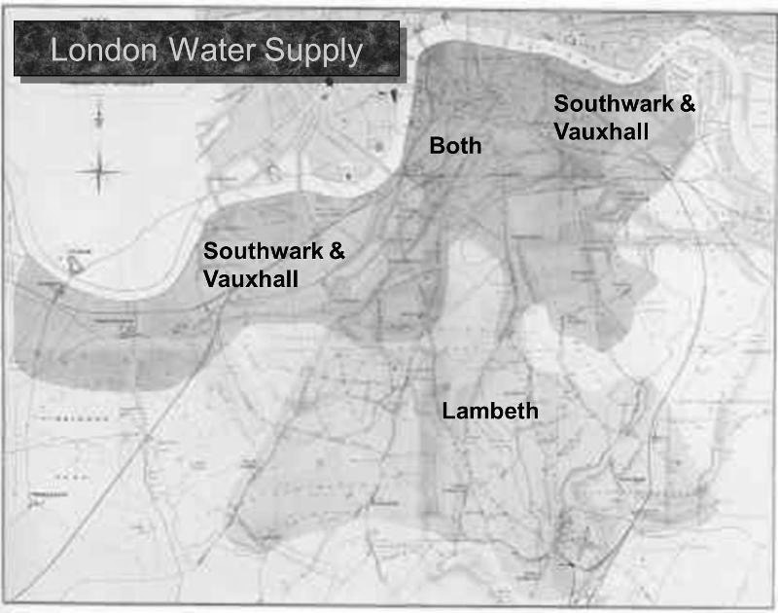
Notes:
- While John had obtained data to support his hypothesis, he needed to do deeper analysis.
- He conducted the “grand experiment” to further show that the contaminated water was associated with the cholera deaths
2 main water companies provided water to the people of Soho – Lambeth, and Southwark & Vauxhall, both of which drew water from River Themes
The Lambeth water company drew its water upriver from where sewage was discharged into the River Thames. Its water was relatively clean.
But the Southwark and Vauxhall (S&V) company drew its water below the sewage discharge, and thus its supply was contaminated.
He choose to focus on the people in the region where both companies served the people who lived there

Slide 27
Snow’s table
Supply Area | Number of houses | Cholera deaths | Deaths per 10,000 houses
S&V | 40,046 | 1,263 | 315
Lambeth | 26,107 | 98 | 37
Rest of London | 256,423 | 1,422 | 59
Notes:
He recorded the cholera deaths for all the houses served in the region by either of the companies
He normalized by 10000 (deaths per 10000) because absolute numbers are incomparable

Slide 28
Snow’s “Grand Experiment”
“… there is no difference whatever in the houses or the people receiving the supply of the two Water Companies, or in any of the physical conditions with which they are surrounded …”
The two groups were similar except for the treatment.
Notes:
Snow’s brilliance lay in identifying two groups that would make his comparison clear.

Slide 29
Comparison
Treatment group: Do receive the treatment
Control group: Do not receive the treatment

Slide 30
Association vs Causation

Slide 31
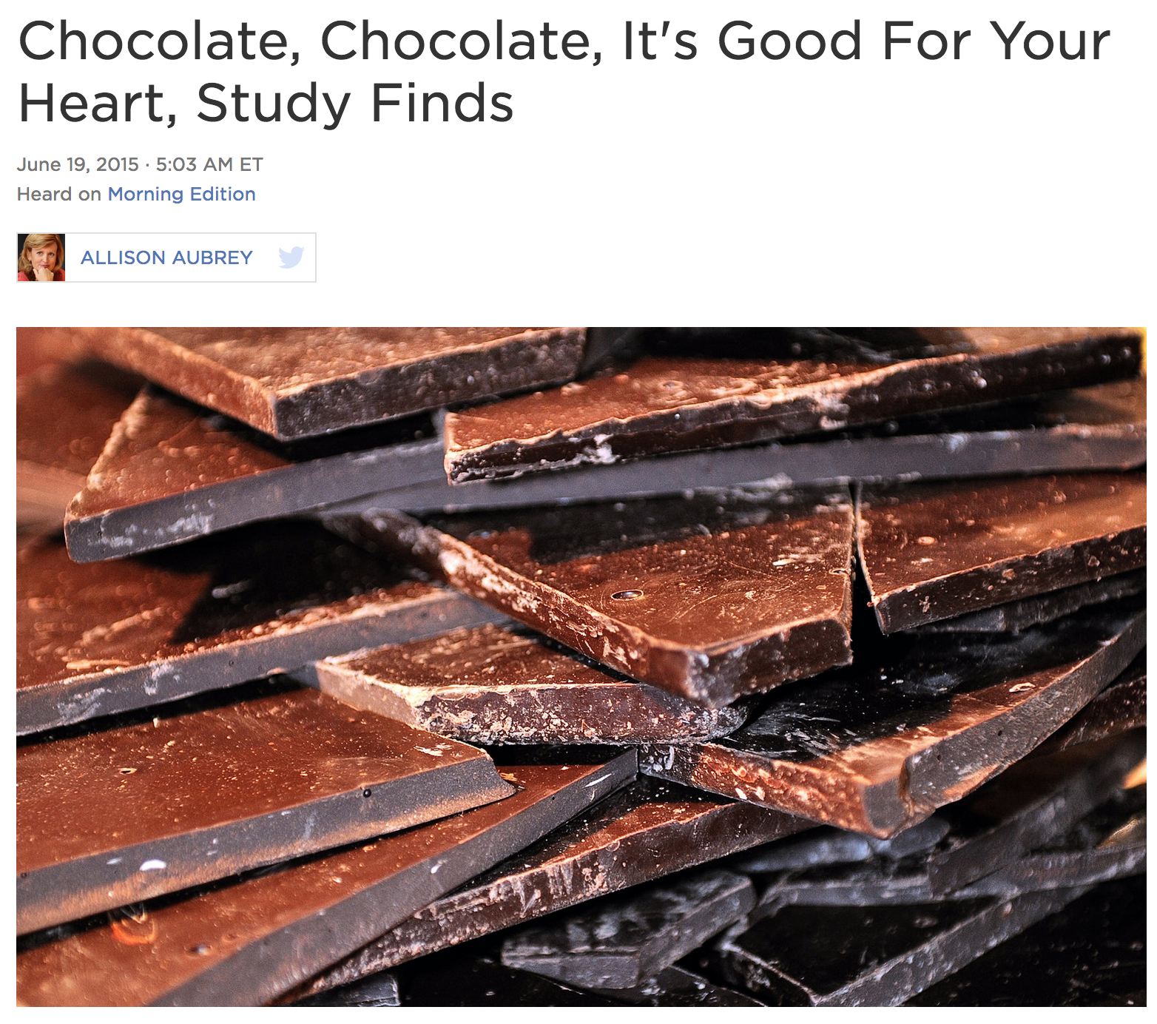
Chocolate and Heart Disease: Study
Population (individuals, study subjects, participants, units): 20K European adults followed for 12 years.
Treatment: chocolate consumption
Outcome: heart disease
https://www.npr.org/sections/thesalt/2015/06/19/415527652/chocolate-chocolate-its-good-for-your-heart-study-finds

Slide 32
Chocolate and Heart Disease: Association
Question 1: Is there any association (any relationship) between chocolate consumption and heart disease?
Data: “Among those in the top tier of chocolate consumption, 12 percent developed or died of cardiovascular disease during the study, compared to 17.4 percent of those who didn’t eat chocolate.”
Answer: Yes, this points to an association

Slide 33
Chocolate and Heart Disease: Causation
Question 2: Does chocolate consumption lead to a reduction in heart disease?
This questions asks about causality
This question is often harder to answer.
“[The study] doesn’t prove a cause-and-effect relationship between chocolate and reduced risk of heart disease and stroke.” - JoAnn Manson, chief of Preventive Medicine at Brigham and Women’s Hospital, Boston

Slide 34
Chocolate and Heart Disease: Alternatives
Question 3: Is the fact that people ate more chocolate the only possible cause for the observed effect of decreased heart disease risk?
For example, suppose the people who ate more chocolate tended to live in European countries with better health care?
What if wealthier people eat more chocolate and can also afford better health care?

Slide 35
Key to establishing causality
If the treatment and control groups are similar apart from the treatment, then differences between the outcomes in the two groups can be ascribed to the treatment.

Slide 36
Confounding
If the treatment and control groups have systematic differences other than the treatment, then it might be difficult to identify causality.
Such differences are often present in observational studies.
When they lead researchers astray, they are called confounding factors.

Slide 37
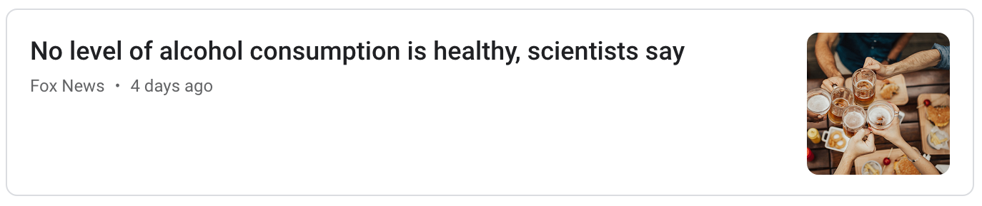
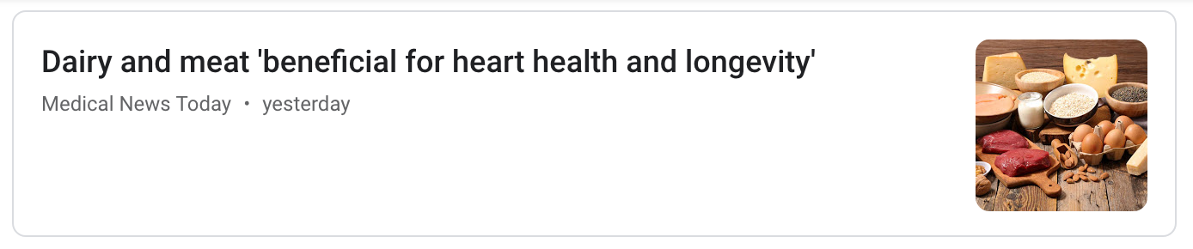
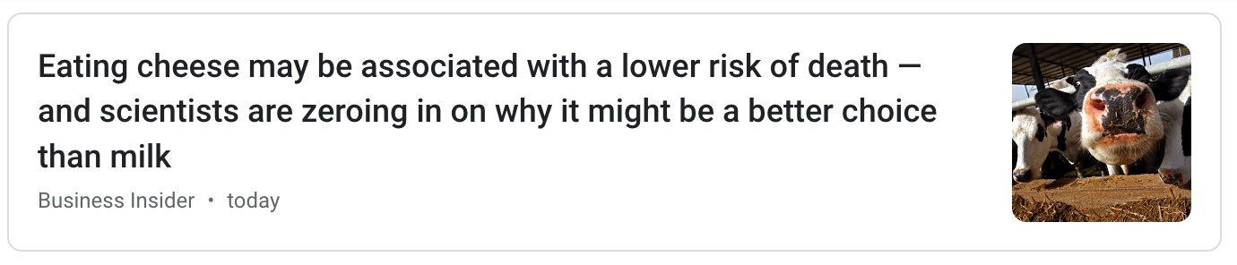
Examples

Slide 38
Randomization and Confounding
If you assign individuals to treatment and control at random, then the two groups are likely to be similar apart from the treatment.
You can account – mathematically – for variability in the assignment.
Randomized Controlled Experiments are the gold standard for establishing cause and effect.
Notes:
But every method of randomization consists of a sequence of carefully defined steps that allow chances to be specified mathematically. This has two important consequences.
It allows us to account–mathematically–for the possibility that randomization produces treatment and control groups that are quite different from each other.
It allows us to make precise mathematical statements about differences between the treatment and control groups. This in turn helps us make justifiable conclusions about whether the treatment has any effect.

Slide 39
RCEs vs Observational Studies
Question: If randomized controlled experiments can establish causality while observational studies are subject to confounding, why are so many studies observational?

